Slide 1
Key Results of CIMP Project

Slide 2
Our Hypothesis
Currently, there is a consensus in the literature that BRAF mutations cause CIMP in colorectal cancer. However, our lab has noticed that some colon cancer samples are BRAF- but CIMP+. Thus, we hypothesized that alternative mechanisms responsible for CIMP must exist in colon cancer, alongside BRAF mutation. To test this hypothesis, we investigated the molecular features of both BRAF+ and BRAF- colon cancer samples, including point mutations, differential gene expression, and pathway enrichment, in search of putative mechanisms other than BRAF mutation that are implicated in aberrant methylation.

Slide 3
We investigated the molecular features of both BRAF+ and BRAF-
We produced a set of 105 features related to CIMP+, and then we utilized several different ranking metrics to determine features which are strong at differentiating between CIMP+ and non-CIMP+. Mutations in BRAF, C5orf24, ATP5EP2, ZBTB20 and XYLT2 mutations appear in the confluence of these methods.
A mutual exclusivity between KRAS and BRAF mutation occurrence can be seen across CIMP+ samples, as well as a higher density of mutations in samples with BRAF in contrast to samples with KRAS.

Slide 4
Union of feature selection methods
Union of feature selection methods
Features were determined by the combination of three methods: selecting features with 9 or more CIMP+ occurrence, Fisher’s Exact pval of < .05, and non-CIMP+ occurrence <= 8 with two KRAS mutations as an exception due to their relation to CIMPi; the union of top 10 features of Info Gain, CART, Fisher’s Exact p-value and Chi Squared p-value; and finally features which were selected by a number of different classification methods.
Feature | TP | FP | TN | FN | Info Gain | CART | Fisher's Exact | Chi Squared
BRAF_GRCh38_7:140753336-140753336_Missense-Mutation_SNP_A-A-T | 29 | 8 | 242 | 81 | 0.081569 | 0.196605 | 2.80E-10 | 9.26E-11
XYLT2_GRCh38_17:50356606-50356606_Frame-Shift-Del_DEL_C-C-- | 15 | 2 | 248 | 95 | 0.052213 | 0.108951 | 6.99E-07 | 5.18E-07
ZBTB20_GRCh38_3:114339156-114339156_Frame-Shift-Del_DEL_G-G-- | 13 | 2 | 248 | 97 | 0.043055 | 0.093519 | 6.94E-06 | 5.82E-06
C5orf24_GRCh38_5:134856972-134856972_3'UTR_DEL_T-T-- | 10 | 2 | 248 | 100 | 0.02987 | 0.07037 | 0.000190999 | 0.000200707
DUS4L_GRCh38_7:107573863-107573863_Intron_DEL_A-A-- | 7 | 0 | 250 | 103 | 0.033897 | 0.054012 | 0.000217033 | 0.000301896
CENPC_GRCh38_4:67519218-67519218_Frame-Shift-Del_DEL_T-T-- | 8 | 1 | 249 | 102 | 0.027639 | 0.058333 | 0.000423139 | 0.000499513
PLEKHA6_GRCh38_1:204259283-204259283_Frame-Shift-Del_DEL_C-C-- | 8 | 1 | 249 | 102 | 0.027639 | 0.058333 | 0.000423139 | 0.000499513
SLC3A2_GRCh38_11:62882057-62882057_Frame-Shift-Del_DEL_A-A-- | 13 | 6 | 244 | 97 | 0.024502 | 0.079938 | 0.000536819 | 0.000613242
ATP5EP2_GRCh38_13:27945509-27945509_3'UTR_DEL_A-A-- | 9 | 2 | 248 | 101 | 0.025653 | 0.062654 | 0.000554411 | 0.000634937
KBTBD11_GRCh38_8:2004005-2004005_3'UTR_DEL_A-A-- | 6 | 0 | 250 | 104 | 0.028975 | 0.046296 | 0.000738746 | 0.00104902
WT1_GRCh38_11:32440050-32440050_5'Flank_DEL_A-A-- | 6 | 0 | 250 | 104 | 0.028975 | 0.046296 | 0.000738746 | 0.00104902
RAB28_GRCh38_4:13484184-13484184_5'UTR_DEL_G-G-- | 7 | 1 | 249 | 103 | 0.023203 | 0.050617 | 0.001292975 | 0.001644459
MAGEA1_GRCh38_X:153183523-153183523_3'UTR_DEL_T-T-- | 10 | 4 | 246 | 100 | 0.020696 | 0.06358 | 0.001588894 | 0.001997627
ELFN1_GRCh38_7:1747385-1747385_3'UTR_DEL_T-T-- | 5 | 0 | 250 | 105 | 0.02408 | 0.03858 | 0.002497666 | 0.003662859
DOCK3_GRCh38_3:51380173-51380173_Frame-Shift-Del_DEL_C-C-- | 10 | 5 | 245 | 100 | 0.017369 | 0.060185 | 0.003531875 | 0.004875304
MAB21L2_GRCh38_4:150584424-150584425_3'UTR_INS_----C | 6 | 1 | 249 | 104 | 0.018866 | 0.042901 | 0.003869027 | 0.005351851
PABPC5_GRCh38_X:91436820-91436820_3'UTR_DEL_T-T-- | 8 | 3 | 247 | 102 | 0.017152 | 0.051543 | 0.004284722 | 0.005933151
GPR88_GRCh38_1:100540788-100540788_3'UTR_DEL_T-T-- | 7 | 2 | 248 | 103 | 0.017567 | 0.047222 | 0.004337401 | 0.005992862
SRFBP1_GRCh38_5:122027171-122027171_3'UTR_DEL_T-T-- | 11 | 7 | 243 | 99 | 0.015134 | 0.061111 | 0.006999586 | 0.008668159
ZNF644_GRCh38_1:90916736-90916736_3'UTR_DEL_A-A-- | 10 | 6 | 244 | 100 | 0.014586 | 0.05679 | 0.009494301 | 0.010464764
MUM1L1_GRCh38_X:106207643-106207643_3'UTR_DEL_T-T--_T---- | 10 | 6 | 244 | 100 | 0.014586 | 0.05679 | 0.009494301 | 0.010464764
FDPS_GRCh38_1:155317840-155317840_Intron_DEL_A-A-- | 5 | 1 | 249 | 105 | 0.014653 | 0.035185 | 0.011292265 | 0.017158162
ATM_GRCh38_11:108247071-108247071_Missense-Mutation_SNP_C-C-T | 5 | 1 | 249 | 105 | 0.014653 | 0.035185 | 0.011292265 | 0.017158162
ZFP36L2_GRCh38_2:43224218-43224218_3'UTR_DEL_C-C-- | 5 | 1 | 249 | 105 | 0.014653 | 0.035185 | 0.011292265 | 0.017158162
KCNMA1_GRCh38_10:76884893-76884893_3'UTR_DEL_T-T--_T---- | 5 | 1 | 249 | 105 | 0.014653 | 0.035185 | 0.011292265 | 0.017158162
ADRB1_GRCh38_10:114046474-114046474_3'UTR_DEL_A-A-- | 5 | 1 | 249 | 105 | 0.014653 | 0.035185 | 0.011292265 | 0.017158162
HNRNPL_GRCh38_19:38840319-38840319_Frame-Shift-Del_DEL_G-G-- | 6 | 2 | 248 | 104 | 0.013744 | 0.039506 | 0.011597186 | 0.017706066
SCN2B_GRCh38_11:118176520-118176520_5'UTR_DEL_A-A-- | 10 | 7 | 243 | 100 | 0.012228 | 0.053395 | 0.014283285 | 0.020209089
ZBTB18_GRCh38_1:244056272-244056272_3'UTR_DEL_A-A-- | 12 | 10 | 240 | 98 | 0.011669 | 0.058642 | 0.016420401 | 0.022480649
BDNF_GRCh38_11:27659149-27659149_Intron_DEL_T-T-- | 8 | 5 | 245 | 102 | 0.011051 | 0.044753 | 0.026442049 | 0.030504538
DDHD1_GRCh38_14:53046612-53046612_3'UTR_DEL_T-T--_T---- | 5 | 2 | 248 | 105 | 0.010117 | 0.03179 | 0.02985036 | 0.050412855
RNF43_GRCh38_17:58357800-58357800_Frame-Shift-Del_DEL_C-C-- | 10 | 8 | 242 | 100 | 0.010214 | 0.05 | 0.032022004 | 0.035737862
ACVR2A_GRCh38_2:147926117-147926117_Frame-Shift-Del_DEL_A-A-- | 8 | 6 | 244 | 102 | 0.008845 | 0.041358 | 0.03763551 | 0.056526199
POU3F2_GRCh38_6:98837429-98837429_3'UTR_DEL_T-T-- | 7 | 4 | 246 | 103 | 0.01057 | 0.040432 | 0.039084289 | 0.036917749
PCLO_GRCh38_7:82953628-82953628_Frame-Shift-Del_DEL_T-T-- | 7 | 4 | 246 | 103 | 0.01057 | 0.040432 | 0.039084289 | 0.036917749
APC_GRCh38_5:112840254-112840255_Frame-Shift-Ins_INS_----A | 7 | 4 | 246 | 103 | 0.01057 | 0.040432 | 0.039084289 | 0.036917749
TET2_GRCh38_4:105241950-105241954_Intron_DEL_TTTTC-TTTTC-- | 7 | 4 | 246 | 103 | 0.01057 | 0.040432 | 0.039084289 | 0.036917749
KRAS_GRCh38_12:25245350-25245350_Missense-Mutation_SNP_C-C-A_C-C-G_C-C-T_C-G-G_C-A-A | 26 | 48 | 202 | 84 | 0.00181 | 0.037654 | 0.395616405 | 0.413393686
KRAS_GRCh38_12:25245347-25245347_Missense-Mutation_SNP_C-C-T_C-T-T | 11 | 20 | 230 | 99 | 0.000759 | 0.016975 | 0.544312398 | 0.675079454

Slide 5
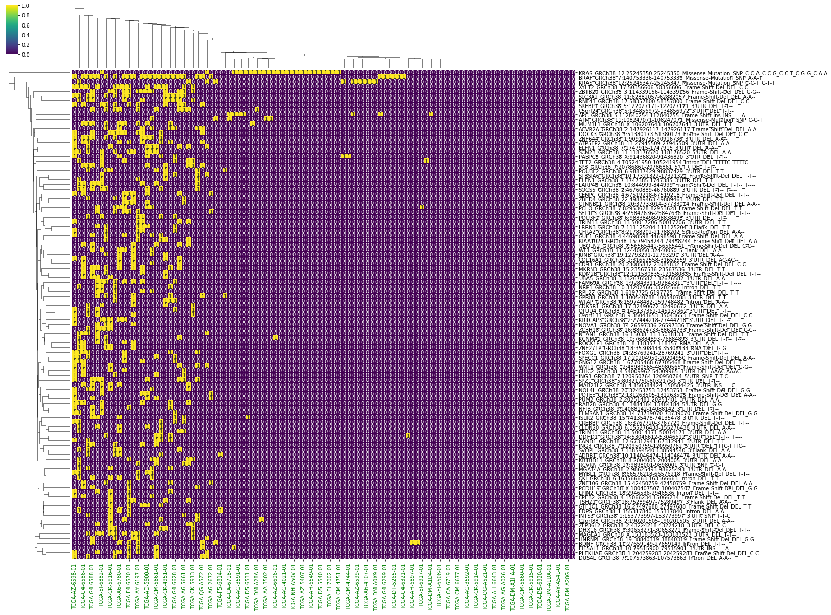
Heatmap of mutation occurrence across CIMP+ samples
CIMP+ samples only
Heatmap of mutation occurrence across CIMP+ samples
Mutation occurrence data using thresholds CIMP+ occurrence >= 5, CIMP- occurrence <= 8
(including outliers KRAS_GRCh38_12:25245350-25245350_Missense-Mutation and KRAS_GRCh38_12:25245347-25245347_Missense-Mutation)
was utilized to generate a heatmap depicting samples, shown as columns, and the mutations occurring within them, shown as rows. Rows 1 and 3 are two KRAS missense mutations, while row 2 is a BRAF mutation. A stark contrast can be seen between the samples which have BRAF and samples which have KRAS, and samples which have BRAF also have a higher overall mutation density.

Slide 6
We investigated the molecular features of both BRAF+ and BRAF-
By clustering CIMP+ samples by their signature data (proportions of mutations attributable to each signature), we find 4 distinct subgroups.
Cluster 1 contains primarily samples which are BRAFV600-mutated. This cluster is associated with signatures relating to MMR deficiency and MSI including Signatures 6, 14, 15, 20, 21, and 26. Genes relating to muscle development, protein methylation and glycosylation are seen in this cluster. KMT2B, KMT2D and TET2 mutations are enriched in this cluster.
Cluster 1 can be further split in two, with some genes of possible interest differentiating the two including USP27X, PREX2 and DNAH7.
Cluster 2 is signified by Signature 1, denoting spontaneous deamination of 5-methylcytosine. It is KRAS-mutated and compared to the other clusters, it’s significantly associated with APC mutations, an antagonist of Wnt signaling pathway.
Cluster 3 has relatively strong signals for Signatures 3 and 4, which are associated with tobacco carcinogens. It also contains genes related to the response to various compounds and the prominent gene mutated in this group is predominantly TP53.
Cluster 4 is a very small group of 3 samples showing strong signals for signatures related to POLE deficiency. They are BRAF-mutated and MSI-High. Mutations in genes related to regulation of lipid storage/localization and protein methylation appear most strongly in this cluster.

Slide 7
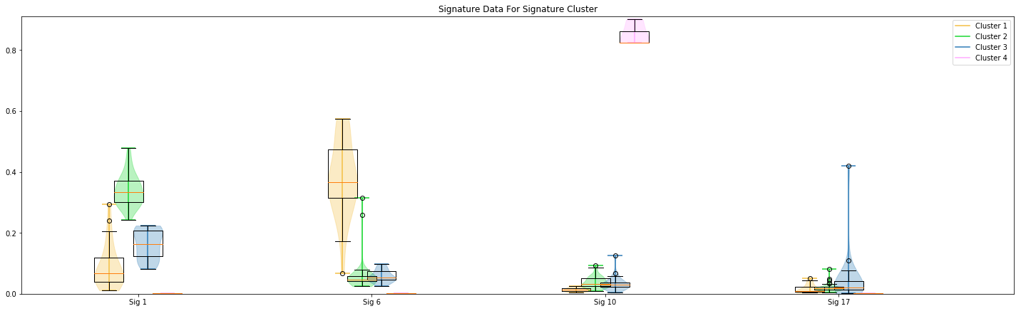
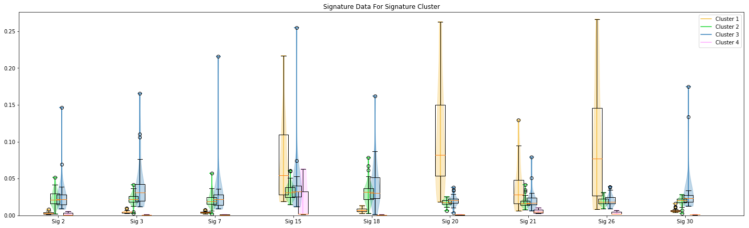
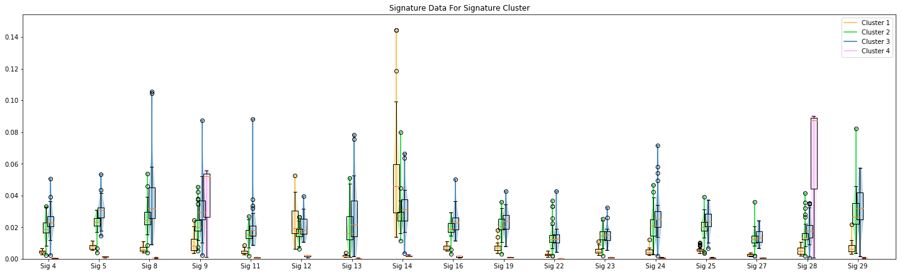
Detailing Groups From the Signature Clustering – Most Significant Comparisons
Method: Ward
Metric: Euclidean
Cluster 1 distinguishing signatures:
Cluster 2 distinguishing signatures:
Signature | Possible significance | Possible Drivers
Signature 6 | Defective DNA mismatch repair, noted in MSI samples. The presence of signature 6 was strongly associated with inactivation of mismatch repair genes in CRC. | PIK3CA, KRAS, BRAF, PTEN
Signature 15 | Shows activity in a small number of cancer cases, possibly due to uncharacterized defects in DNA maintenance. Associated with defective DNA mismatch repair. | ?
Signature 20 | Associated with loss of MMR and POLD1 proofreading deficiency. | BCOR, KRAS, POLE, PTEN
Signature 21 | Shows activity in a small number of cancer cases, possibly due to uncharacterized defects in DNA maintenance. | ?
Signature 26 | Defective DNA mismatch repair, noted in MSI samples. | PIK3CA, BRAF, TP53
Signature 14 | May represent mutations that only accumulate in tumors lacking both POLE and MMR repair functions. This signature may be the combination of two distinct signatures. | PIK3CA, POLE, PTEN
Signature | Possible significance | Possible Drivers
Signature 1 | Spontaneous deamination of 5-methylcytosine. | IDH1 (negative association)
Cluster 3 distinguishing signatures:
Signature | Possible significance | Possible Drivers
Signature 17 | Predominantly consists of T>G mutations and has been found in oesophagus cancer, breast cancer, liver cancer, lung adenocarcinoma, B-cell lymphoma, stomach cancer and melanoma. | IDH1 (negative association)
Signature 3 | Defective homologous-recombination-based DNA double-strand break repair. | PTEN, PPP2R1A, POLE, PIK3CA, KRAS, ARID1A
Signature 4 | Sometimes found in cancers associated with tobacco smoking | KRAS, EGFR
Signature 5 | Predominantly C>T and T>C mutations and has some association with tobacco carcinogens | ?
Signature 8 | Shows strong transcriptional strand bias, possibly relating to transcription-coupled nucleotide excision repair acting on bulky DNA adducts | ?
Signature 11 | Sometimes found in melanomas and glioblastomas treated with alkylating agent | ?
Signature 16 | Shows strong transcriptional strand bias, possibly relating to transcription-coupled nucleotide excision repair acting on bulky DNA adducts | ?
Signature 24 | Found in cancer samples with known exposures to aflatoxin. May exhibit guanine damage that is repaired by transcription-coupled nucleotide excision repair. | ?
Signature 25 | Sometimes observed in Hodgkin lymphomas | ?
Cluster 4 distinguishing signatures:
Signature | Possible significance | Possible Drivers
Signature 10 | Altered activity of the error-prone polymerase POLE. | IDH1 (negative association)
Signature 9 | T>G transversions, found in cancers that have undergone somatic immunoglobulin gene hypermutation (IGHV-mutated) associated with AIDs. | ?
Signature 28 | Observed in a subset of stomach cancers. | ?

Slide 8
Putative mechanisms other than BRAF mutation that are implicated in aberrant methylation.
By clustering CIMP+ samples by their signature data (proportions of mutations attributable to each signature), we find 4 distinct subgroups.
Cluster 1 contains primarily samples which are BRAFV600-mutated. This cluster is associated with signatures relating to MMR deficiency and MSI including Signatures 6, 14, 15, 20, 21, and 26. Genes relating to muscle development, protein methylation and glycosylation are seen in this cluster. KMT2B, KMT2D and TET2 mutations are enriched in this cluster.
Cluster 1 can be further split in two, with some genes of possible interest differentiating the two including USP27X, PREX2 and DNAH7.
Cluster 2 is signified by Signature 1, denoting spontaneous deamination of 5-methylcytosine. It is KRAS-mutated and compared to the other clusters, it’s significantly associated with APC mutations, an antagonist of Wnt signaling pathway.
Cluster 3 has relatively strong signals for Signatures 3 and 4, which are associated with tobacco carcinogens. It also contains genes related to the response to various compounds and the prominent gene mutated in this group is predominantly TP53.
Cluster 4 is a very small group of 3 samples showing strong signals for signatures related to POLE deficiency. They are BRAF-mutated. Mutations in genes related to regulation of lipid storage/localization and protein methylation appear most strongly in this cluster.

Slide 9
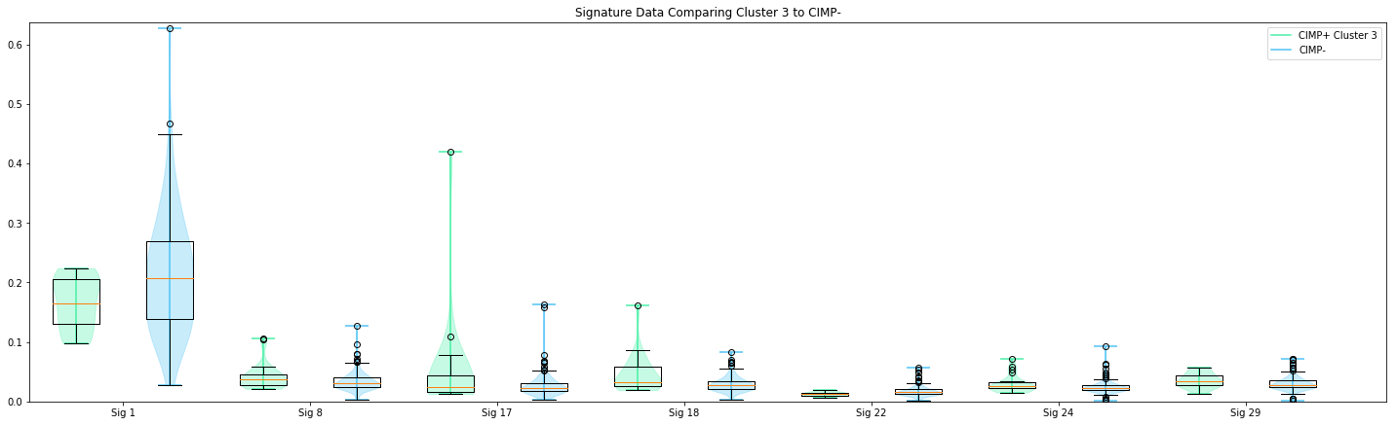
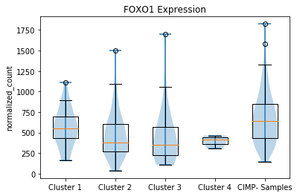
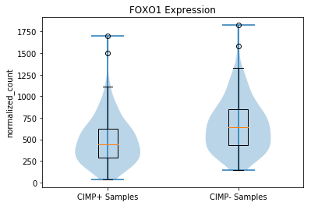
A proposed mode of Cluster 3’s Involvement in FoxO Pathway
Foreground: TP53-mutated CIMP+ Cluster 3 Samples
Background: TP53-mutated CIMP- Samples
1. Difference between Cluster 3 and TP53-mutated CIMP-:
Significantly higher percentages of mutations attributable to Signature 18, which may reflect an enhanced production of ROS.
Increased in Cluster 3
Signature | Possible significance | Possible Drivers
Signature 8 | Shows strong transcriptional strand bias, possibly relating to transcription-coupled nucleotide excision repair acting on bulky DNA adducts | ?
Signature 17 | Predominantly consists of T>G mutations and has been found in oesophagus cancer, breast cancer, liver cancer, lung adenocarcinoma, B-cell lymphoma, stomach cancer and melanoma | IDH1 (negative association)
Signature 18 | Reported to be due to reactive oxygen species and may reflect an enhanced production of ROS. A signature associated with defective MUTYH, a glycosylase that excises 8-oxoG from DNA, strongly resembles Signature 18 | ?
Signature 24 | Found in cancer samples with known exposures to aflatoxin. May exhibit guanine damage that is repaired by transcription-coupled nucleotide excision repair | ?
Signature 29 | Associated with tobacco chewing. May indicate guanine damage that is repaired by transcription-coupled nucleotide excision repair | ?
.031
.039
.004
8e-06
.015
.020
.034
Clust2 and CIMP- have p-value of 0.00016
Clust3 and CIMP- have p-value of 0.00366
* 2.4e-05
2. Expression of FoxO in Cluster 3:
We see a very strong difference of expression between FoxO1 in CIMP+ vs. CIMP- Samples. CIMP+ is depleted. Breaking it down, we see that Cluster 2 and Cluster 3 are both significantly depleted compared to CIMP-.
3. Previously observed behavior of p53/FoxO1 interaction:
p53 activates expression of SIRT6, whose interaction with FoxO1 leads to FoxO1 deacetylation and export to the cytoplasm (doi: 10.1016/j.cellbi.2009.04.017). This allows it to modulate gluconeogenesis. Cell-based assays were used to demonstrate the nuclear exclusion of FoxO1. Additionally, it has been seen that cytoplasmic FoxO proteins are ubiquitinated and degraded in the proteasome (doi: 10.1016/j.cellbi.2009.04.017). Thus, p53 may indirectly lead to the destruction of FoxO1 protein (doi: 10.1016/j.cellbi.2009.04.017). It is also well-known that FOXO forms protein complexes with other proteins to mutually regulate the activity of itself, as well as other TFs.
4. Previously observed behavior of p53/FoxO3 interaction:
p53 has been found to inhibit FoxO3 activity under conditions of oxidative stress (doi: 10.1016/j.cellbi.2009.04.017). The results of the study suggest that p53 binds to and inhibits FoxO3a activity. It’s also remarked that Fox03a is possibly modified by stimulation of oxidative stress. Thus, the amount of FoxO3 protein in the nucleus may remain normal, although the function may vary. p53 inhibited Fox03a activity, but FoxO3a was not found to affect p53.

Slide 10
Extras??

Slide 11
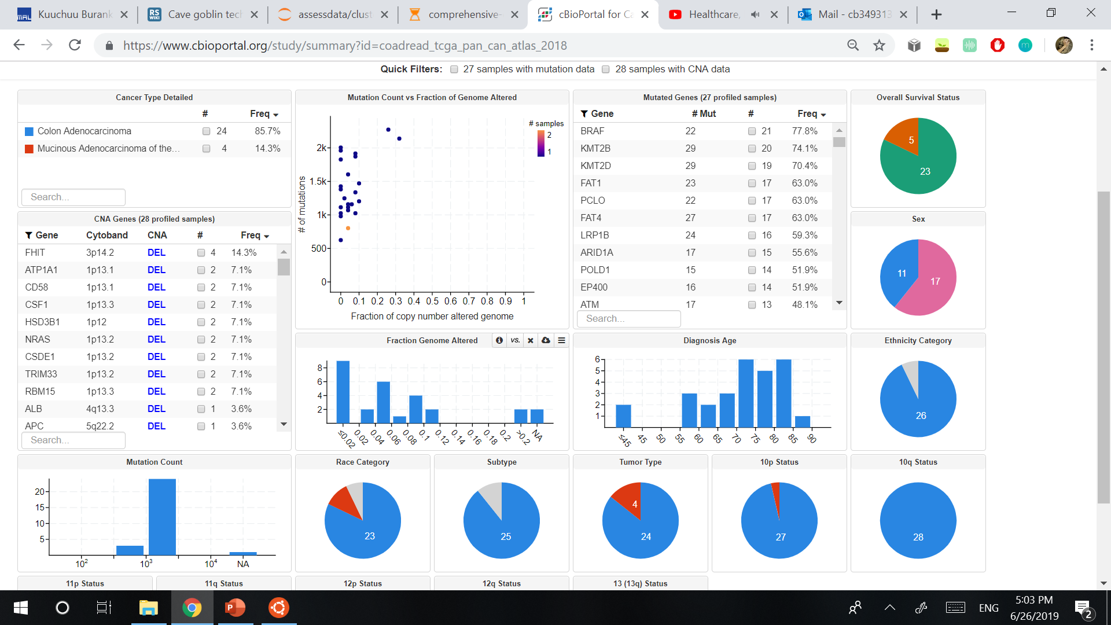
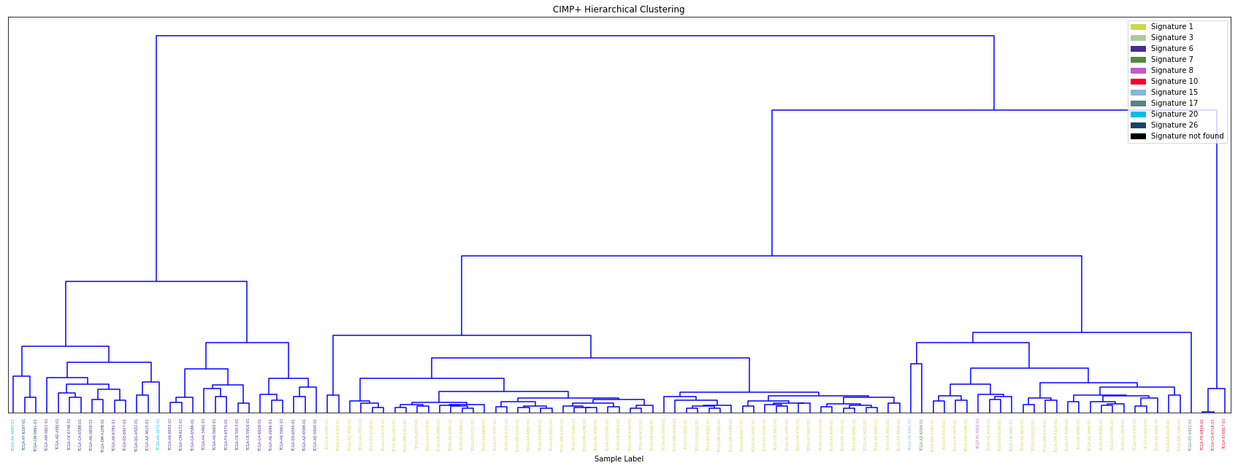
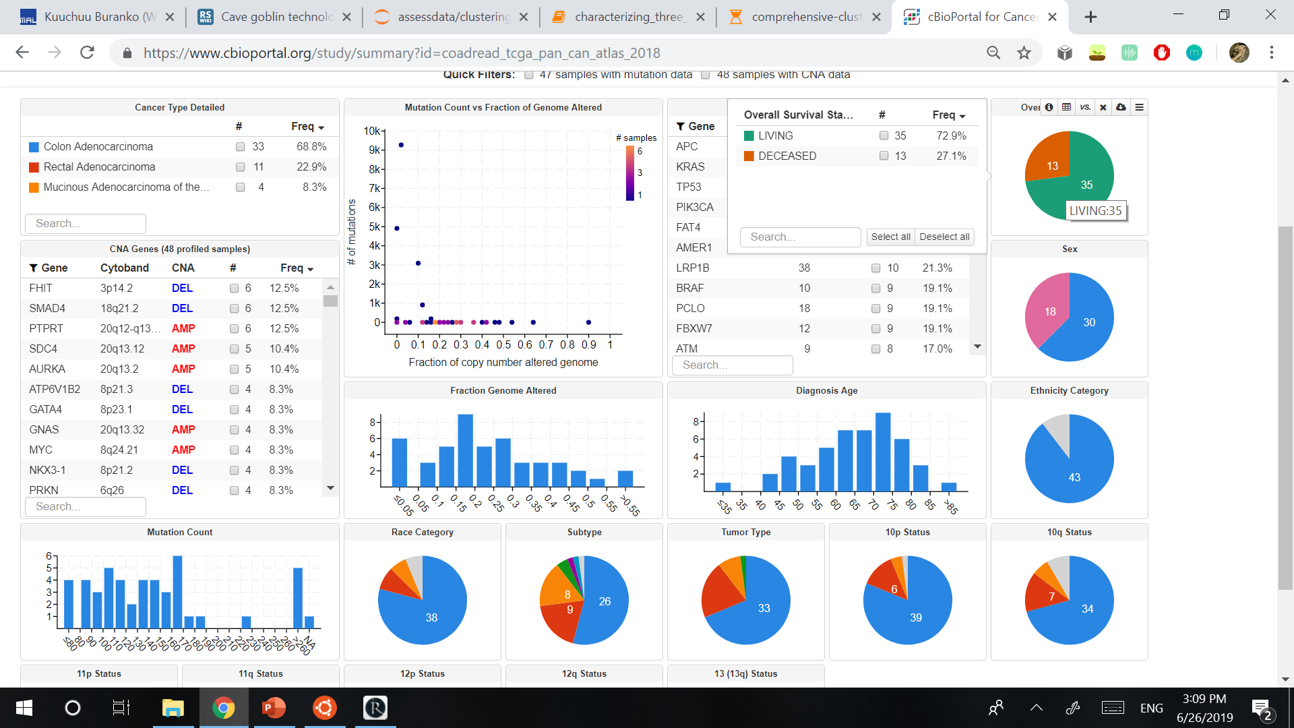
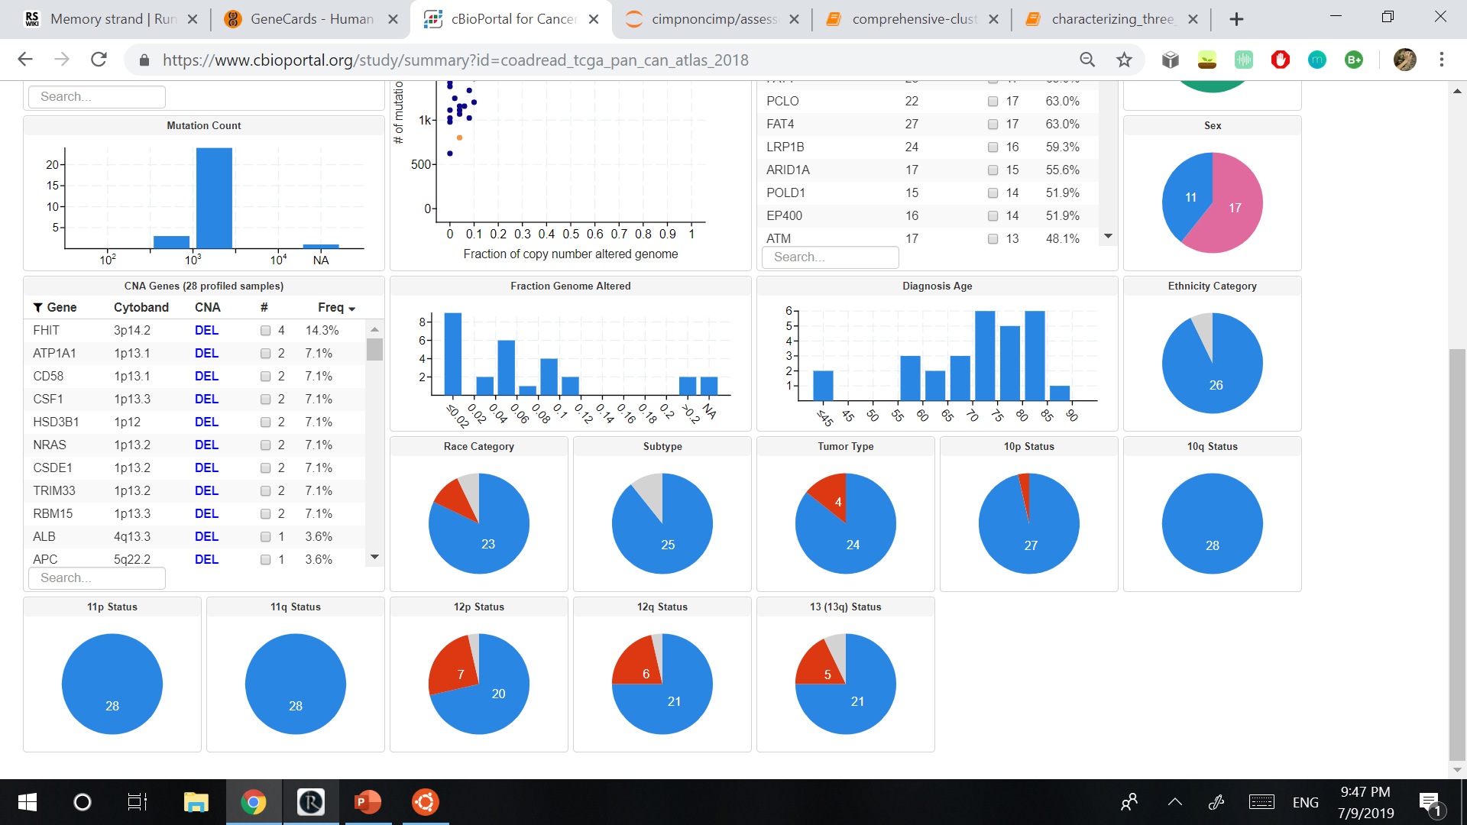
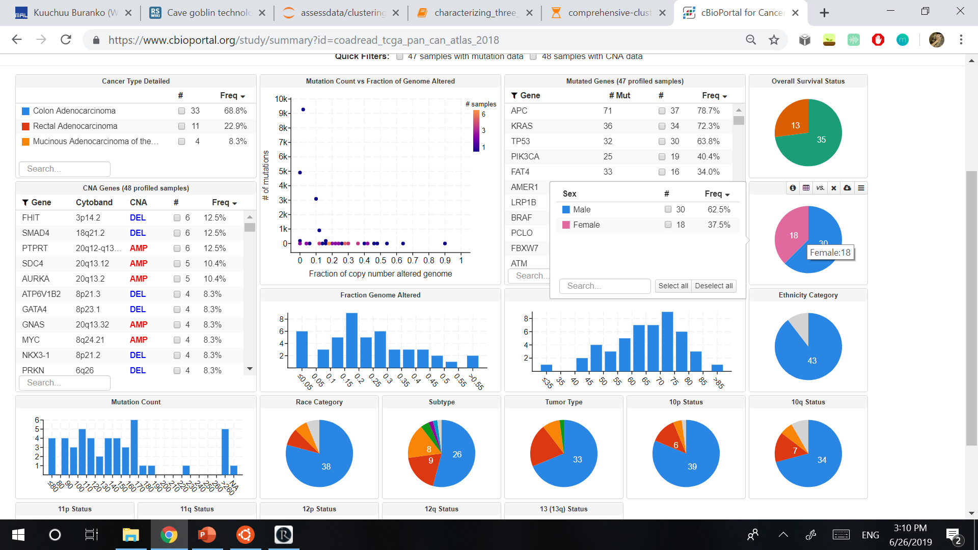
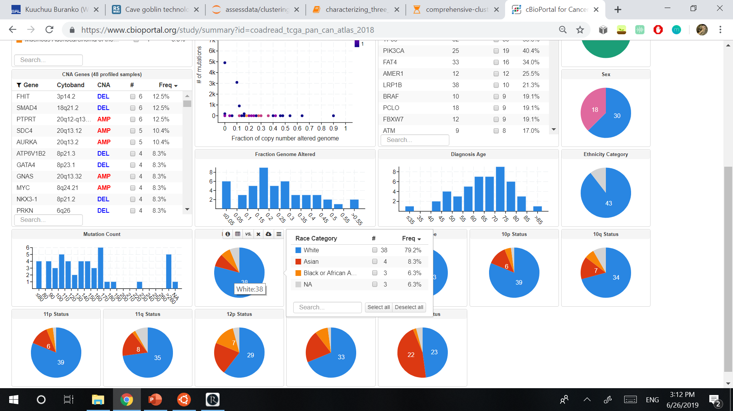
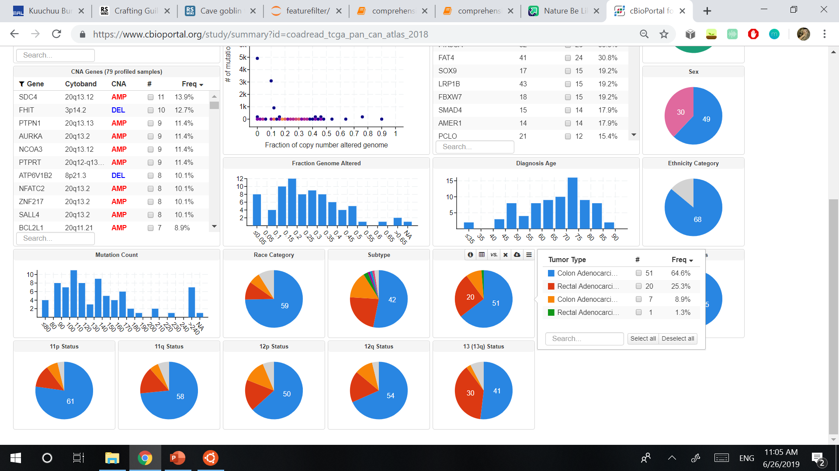
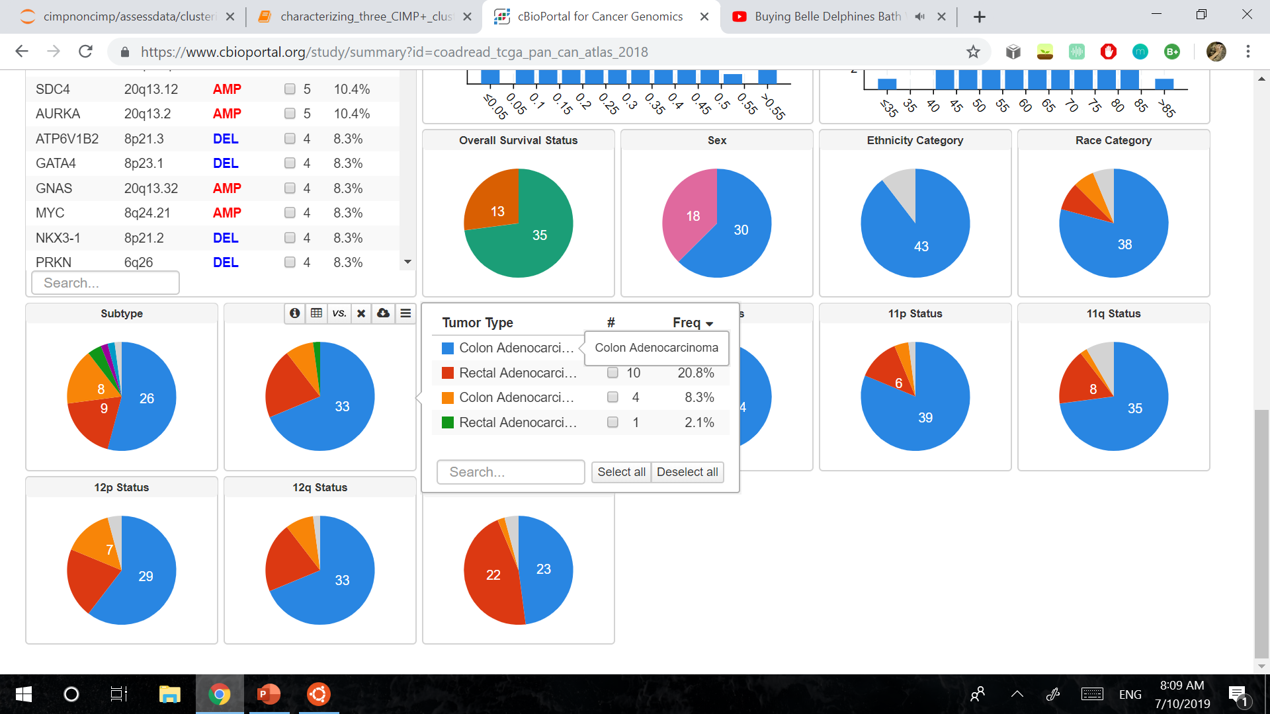

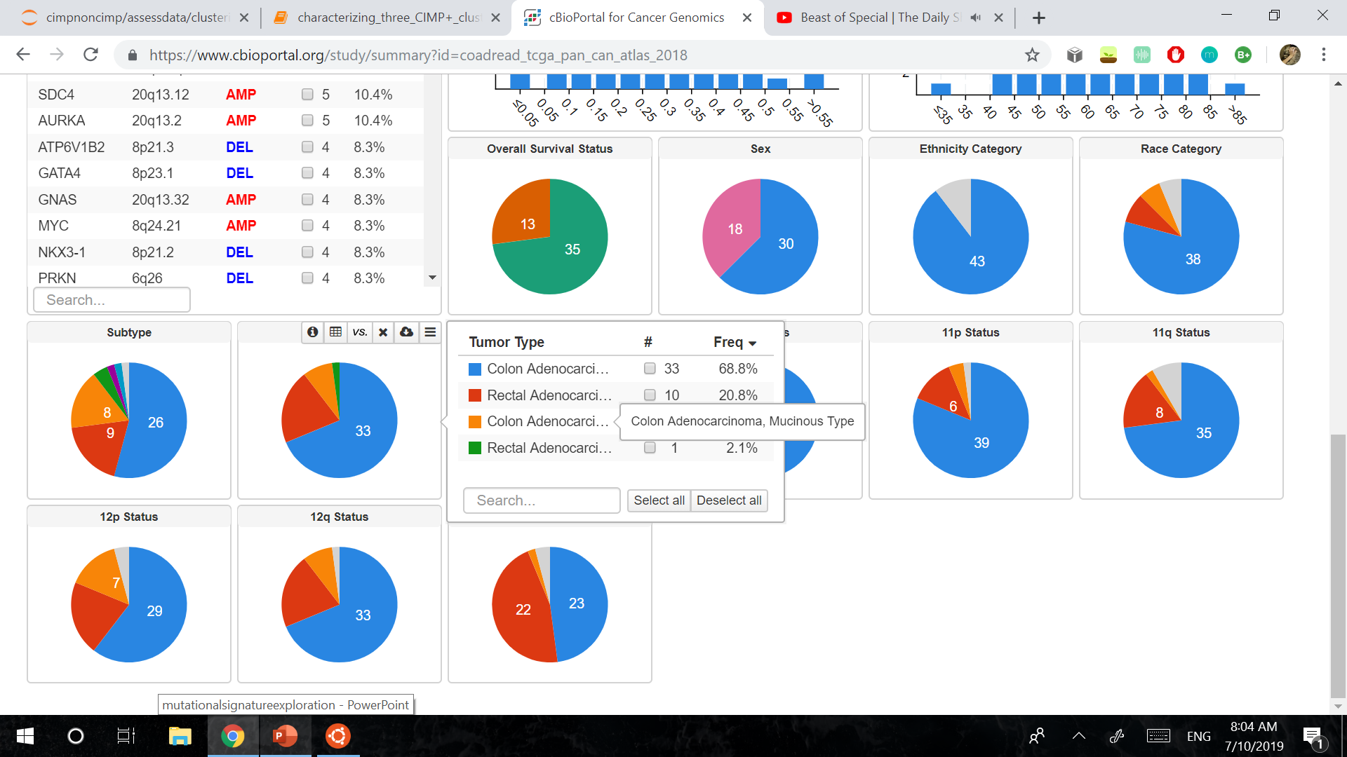

Foreground: Cluster 1
Background: All other CIMP+
CLUSTER 1 Mutations at Gene Level
Table:
Genes with >= 19 TP for Cluster 1 and p-value <= .05
Figure:
Genes with mutation occurrence >= 25
Gene | TP | FP | TN | FN | Fisher's Exact p-value | GeneCards info
TTN | 28 | 41 | 40 | 0 | 3.85E-07 | Encodes a large protein of striated muscle.
OBSCN | 23 | 19 | 62 | 5 | 5.63E-08 | Encodes a large signaling protein like titin.
SYNE1 | 23 | 24 | 57 | 5 | 1.56E-06 | Protein expressed in muscle and peripheral blood lymphocytes.
KMT2D | 22 | 8 | 73 | 6 | 2.05E-11 | Deactivation of the transactivating complex and stimulation of transcription by PKN1.
KMT2B | 22 | 8 | 73 | 6 | 2.05E-11 | Contains multiple domains including a CXXC and PHD zinc fingers, FY-rich domains & a SET domain.
BRAF | 22 | 12 | 69 | 6 | 1.41E-09 | Regulates the MAP kinase/ERK signaling pathway.
SOX11 | 22 | 21 | 60 | 6 | 1.32E-06 | Involved in regulation of embryonic development and determination of cell fate.
MUC16 | 22 | 25 | 56 | 6 | 1.55E-05 | Role in forming protective mucous barrier in epithelia.
MACF1 | 21 | 7 | 74 | 7 | 5.19E-11 | Protein containing many spectrin and LRR domains.
PCLO | 21 | 14 | 67 | 7 | 5.46E-08 | Involved in establishing active synaptic zones and in synaptic vesicle trafficking.
MUC5B | 21 | 14 | 67 | 7 | 5.46E-08 | Lubrication of saliva, lung mucus and cervical mucus.
HERC2 | 20 | 6 | 75 | 8 | 1.15E-10 | Related to ligase activity and ubiquitin protein ligase binding.
TET2 | 20 | 7 | 74 | 8 | 4.02E-10 | Involved in myelopoiesis.
DST | 20 | 12 | 69 | 8 | 6.22E-08 | Anchoring neural filaments to actin cytoskeleton.
RAP2B | 19 | 4 | 77 | 9 | 5.10E-11 | Belongs to a family of genes very similar to RAS.
SVIL | 19 | 4 | 77 | 9 | 5.10E-11 | Associated with actin filaments & plasma membranes.
EP400 | 19 | 8 | 73 | 9 | 8.37E-09 | Related to chromatin binding and helicase activity.
RNF213 | 19 | 12 | 69 | 9 | 3.41E-07 | Zn-Finger involved in protein-protein interactions.
PCDH10 | 19 | 12 | 69 | 9 | 3.41E-07 | Neuron receptor for establishing cell-cell connections.
RYR2 | 19 | 13 | 68 | 9 | 7.48E-07 | Component of calcium channel for cardiac muscle.
AHNAK2 | 19 | 13 | 68 | 9 | 7.48E-07 | Role in calcium signaling via calcium channel proteins.
FUT9 | 19 | 18 | 63 | 9 | 2.19E-05 | Catalyzes last step of LeX antigen biosynthesis in golgi.
FAT4 | 19 | 28 | 53 | 9 | 0.003588422 | May play a role in regulating planar cell polarity.
Associated signatures
Signature | Possible significance | Possible Drivers
Signature 6 | Defective DNA mismatch repair, noted in MSI samples. The presence of signature 6 was strongly associated with inactivation of mismatch repair genes in CRC. | PIK3CA, KRAS, BRAF, PTEN
Signature 15 | Shows activity in a small number of cancer cases, possibly due to uncharacterized defects in DNA maintenance. Associated with defective DNA mismatch repair. | ?
Signature 20 | Associated with loss of MMR and POLD1 proofreading deficiency. | BCOR, KRAS, POLE, PTEN
Signature 21 | Shows activity in a small number of cancer cases, possibly due to uncharacterized defects in DNA maintenance. | ?
Signature 26 | Defective DNA mismatch repair, noted in MSI samples. | PIK3CA, BRAF, TP53
Signature 14 | May represent mutations that only accumulate in tumors lacking both POLE and MMR repair functions. This signature may be the combination of two distinct signatures. | PIK3CA, POLE, PTEN

Slide 12
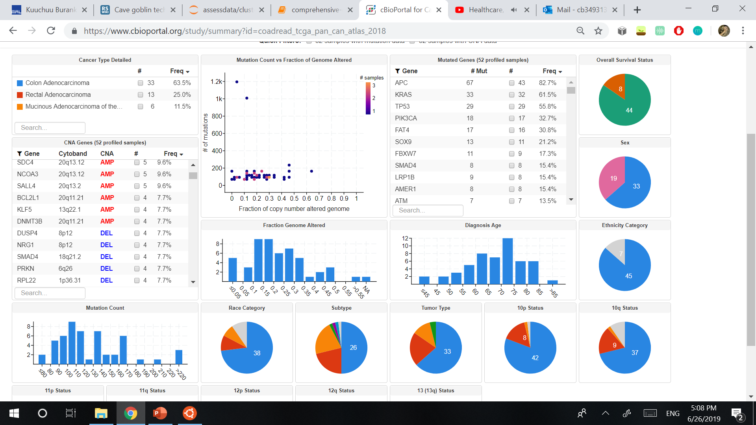
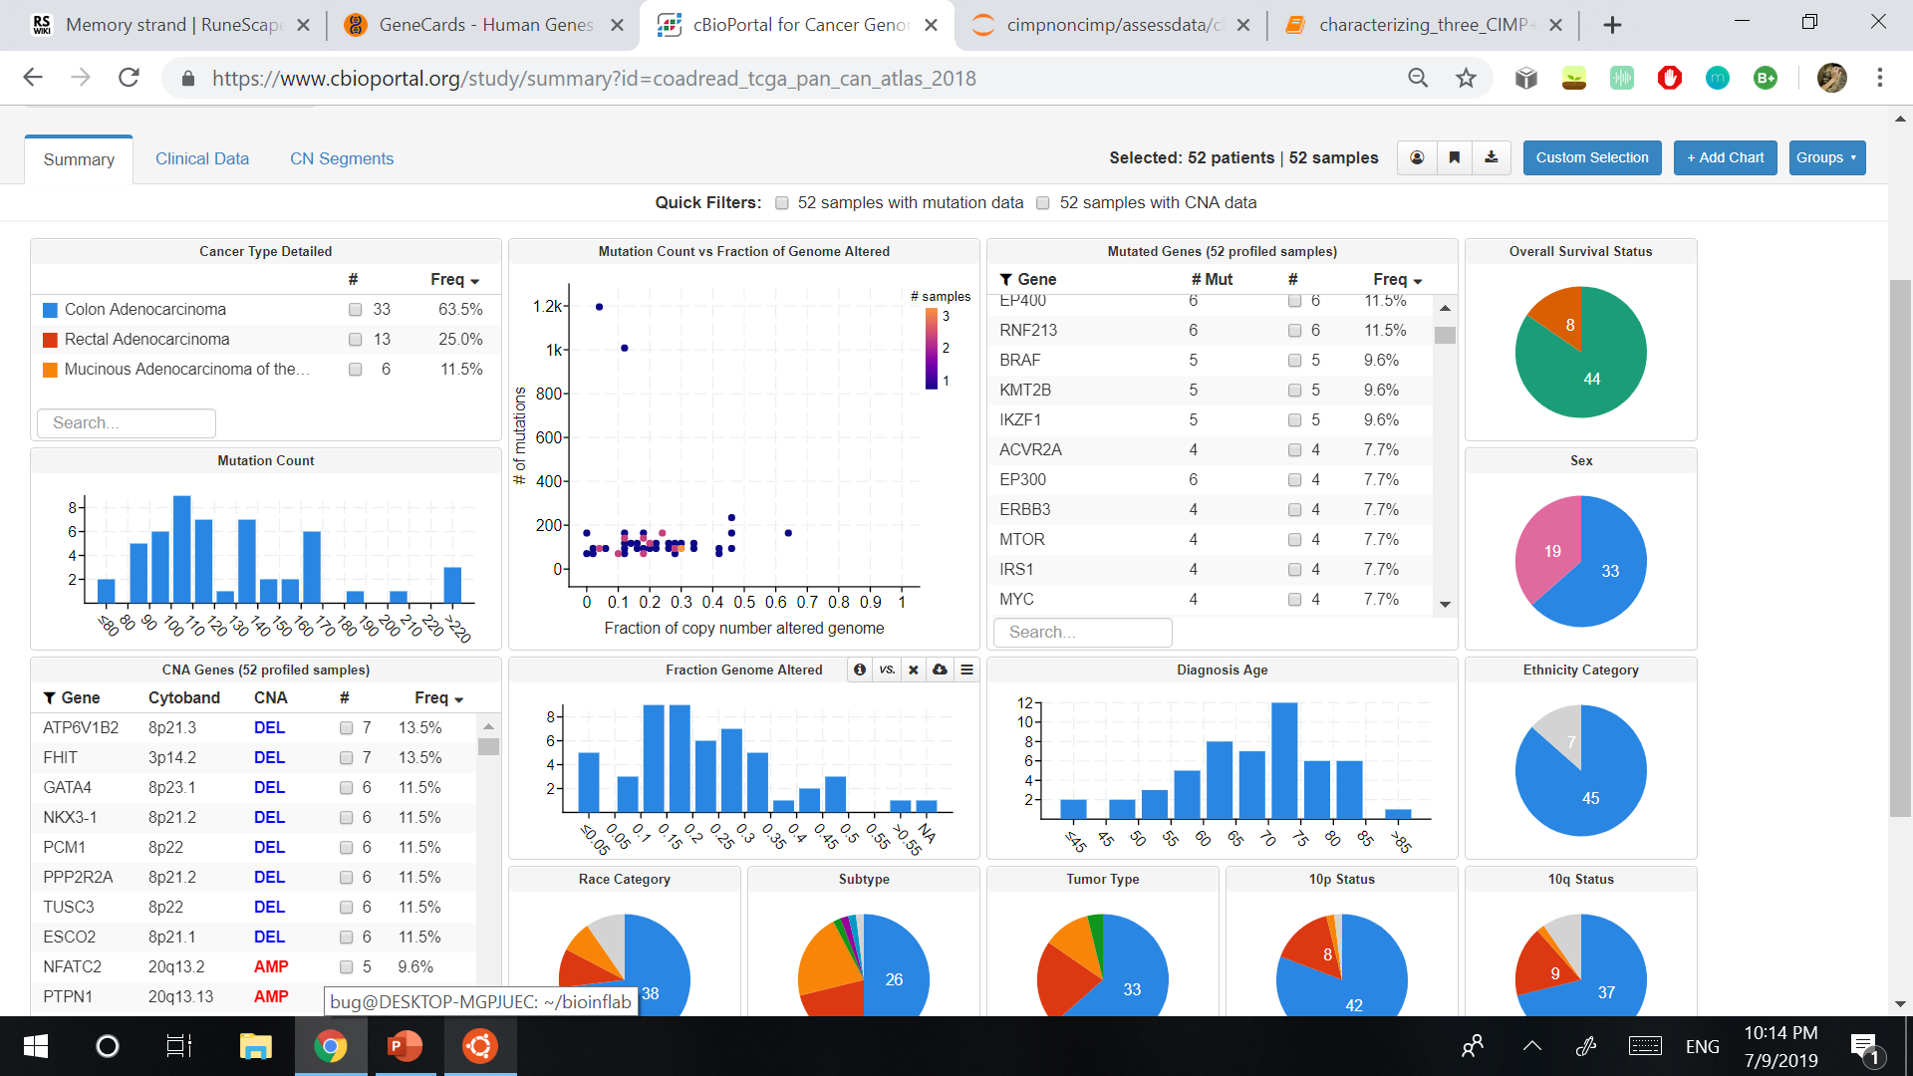
Foreground: Cluster 2
Background: All other CIMP+
CLUSTER 2 Mutations at Gene Level
Table:
Genes with >= 8 TP for Cluster 2 and p-value <= .05
Figure:
Genes with mutation occurrence >= 8
Gene | TP | FP | TN | FN | Fisher's Exact p-value | GeneCards info
APC | 43 | 33 | 24 | 9 | 0.006477579 | Antagonist of Wnt signaling pathway.
KRAS | 31 | 19 | 38 | 21 | 0.007316736 | Proto-oncogene that encodes a protein that is a member of the small GTPase superfamily.
TTN | 26 | 43 | 14 | 26 | 0.00933319 | Encodes a large protein of striated muscle.
MUC16 | 15 | 32 | 25 | 37 | 0.006450383 | Role in forming protective mucous barrier in epithelia.
SYNE1 | 13 | 34 | 23 | 39 | 0.00043581 | Protein expressed in muscle and peripheral blood lymphocytes.
OBSCN | 10 | 32 | 25 | 42 | 8.19E-05 | Encodes a large signaling protein like titin.
PCDH10 | 9 | 22 | 35 | 43 | 0.01903679 | Neuron receptor for establishing cell-cell connections.
RYR1 | 9 | 23 | 34 | 43 | 0.011250735 | Calcium release channel in the sarcoplasmic reticulum.
ZFHX4 | 8 | 23 | 34 | 44 | 0.005410636 | May be related to nucleic acid binding and actin binding.
LRP1B | 8 | 25 | 32 | 44 | 0.001611523 | Receptors with a wide variety of roles in cell function and development due to interactions with multiple ligands.
CSMD3 | 8 | 25 | 32 | 44 | 0.001611523 | Involved in dendrite development.
MUC4 | 8 | 26 | 31 | 44 | 0.000846259 | Encodes an integral membrane glycoprotein found on the cell surface.
Associated signatures
Signature | Possible significance | Possible Drivers
Signature 1 | Spontaneous deamination of 5-methylcytosine. | IDH1 (negative association)

Slide 13
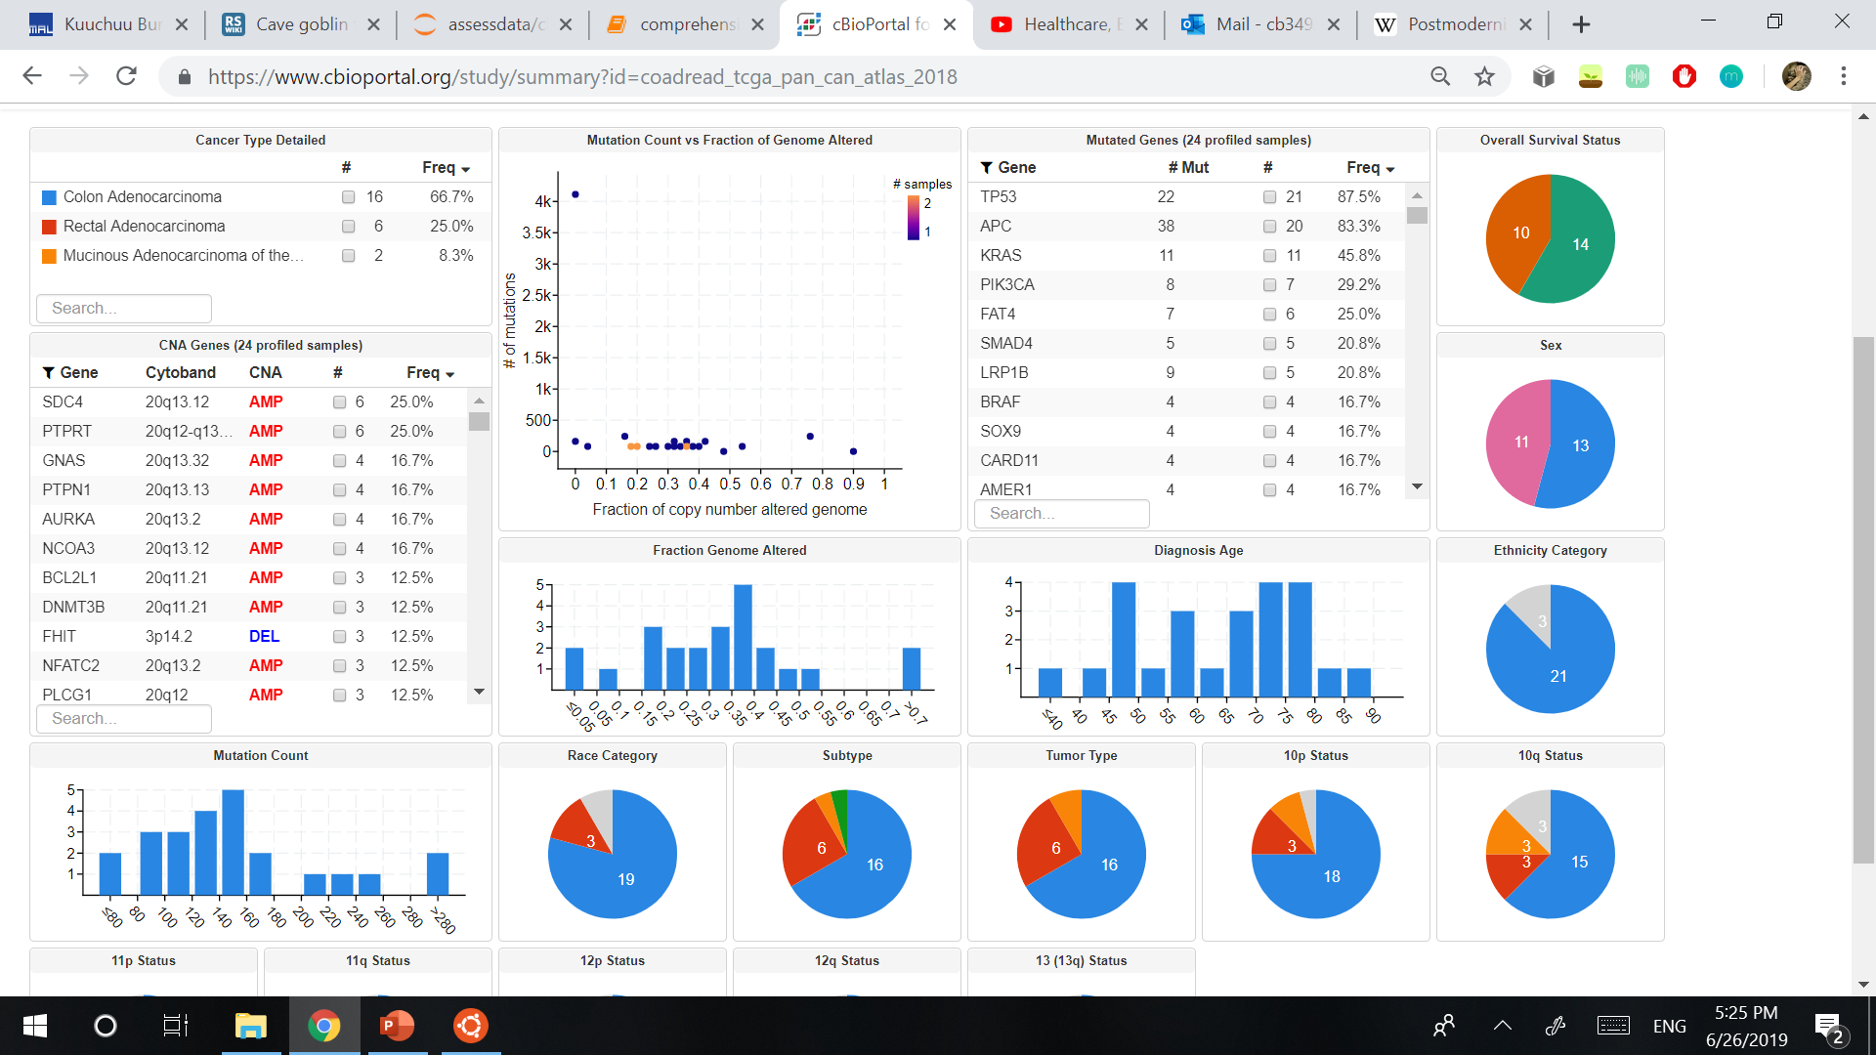
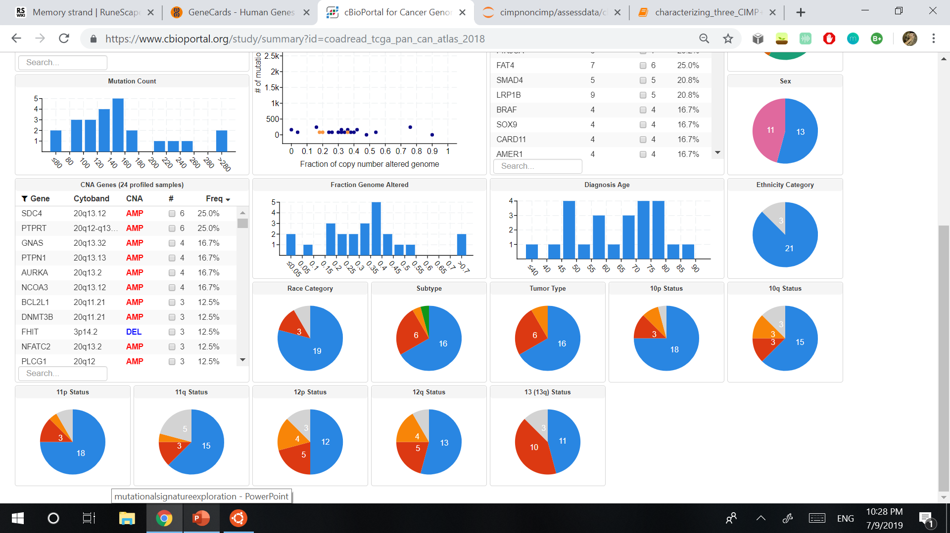

Foreground: Cluster 3
Background: All other CIMP+
CLUSTER 3 Mutations at Gene Level
Table:
Genes with >= 3 TP for Cluster 3 and p-value <= .05
Figure:
Genes with mutation occurrence >= 8
Gene | TP | FP | TN | FN | Fisher's Exact p-value | GeneCards info
TP53 | 23 | 40 | 43 | 3 | 0.000224317 | Protein responds to diverse cellular stresses to regulate expression of target genes.
LHX4 | 3 | 0 | 83 | 23 | 0.012384845 | Encodes TF involved in differentiation and development of pituitary gland.
ZNF211 | 3 | 0 | 83 | 23 | 0.012384845 | May play a role in developmental processes.
NPEPPS | 3 | 0 | 83 | 23 | 0.012384845 | Involved in proteolytic events regulating the cell cycle.
OSCAR | 3 | 0 | 83 | 23 | 0.012384845 | Plays critical roles in the regulation of both innate and adaptive immune responses.
LGALS3BP | 3 | 1 | 82 | 23 | 0.041477546 | Implicated in immune response associated with natural killer (NK) and lymphokine-activated killer (LAK) cell cytotoxicity.
SERINC4 | 3 | 1 | 82 | 23 | 0.041477546 | Related pathways in AA synthesis and viral mRNA translation.
HCN1 | 3 | 1 | 82 | 23 | 0.041477546 | Protein contributes to the pacemaker currents in heart and neurons.
SUSD2 | 3 | 1 | 82 | 23 | 0.041477546 | May be related to scavenger receptor activity and polysaccharide binding.
RYR3 | 3 | 28 | 55 | 23 | 0.044271854 | Functions to release calcium from intracellular storage for use in cellular processes.
RYR2 | 3 | 29 | 54 | 23 | 0.026168736 | Component of calcium channel for cardiac muscle.
AHNAK2 | 3 | 29 | 54 | 23 | 0.026168736 | Role in calcium signaling via calcium channel proteins.
Associated signatures
Signature | Possible significance | Possible Drivers
Signature 17 | Predominantly consists of T>G mutations and has been found in oesophagus cancer, breast cancer, liver cancer, lung adenocarcinoma, B-cell lymphoma, stomach cancer and melanoma. | IDH1 (negative association)
Signature 3 | Defective homologous-recombination-based DNA double-strand break repair. | PTEN, PPP2R1A, POLE, PIK3CA, KRAS, ARID1A
Signature 4 | Sometimes found in cancers associated with tobacco smoking | KRAS, EGFR
Signature 5 | Predominantly C>T and T>C mutations and has some association with tobacco carcinogens | ?
Signature 8 | Shows strong transcriptional strand bias, possibly relating to transcription-coupled nucleotide excision repair acting on bulky DNA adducts | ?
Signature 11 | Sometimes found in melanomas and glioblastomas treated with alkylating agent | ?
Signature 16 | Shows strong transcriptional strand bias, possibly relating to transcription-coupled nucleotide excision repair acting on bulky DNA adducts | ?
Signature 24 | Found in cancer samples with known exposures to aflatoxin. May exhibit guanine damage that is repaired by transcription-coupled nucleotide excision repair. | ?
Signature 25 | Sometimes observed in Hodgkin lymphomas | ?

Slide 14
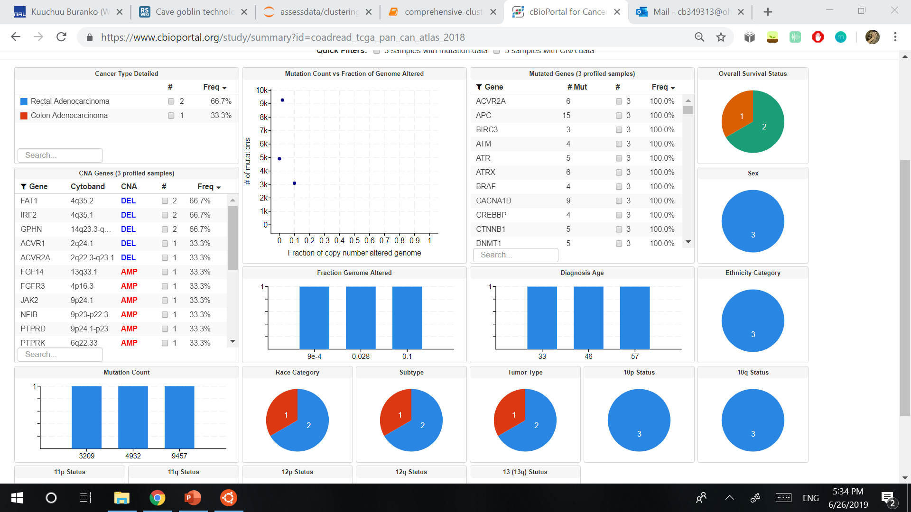
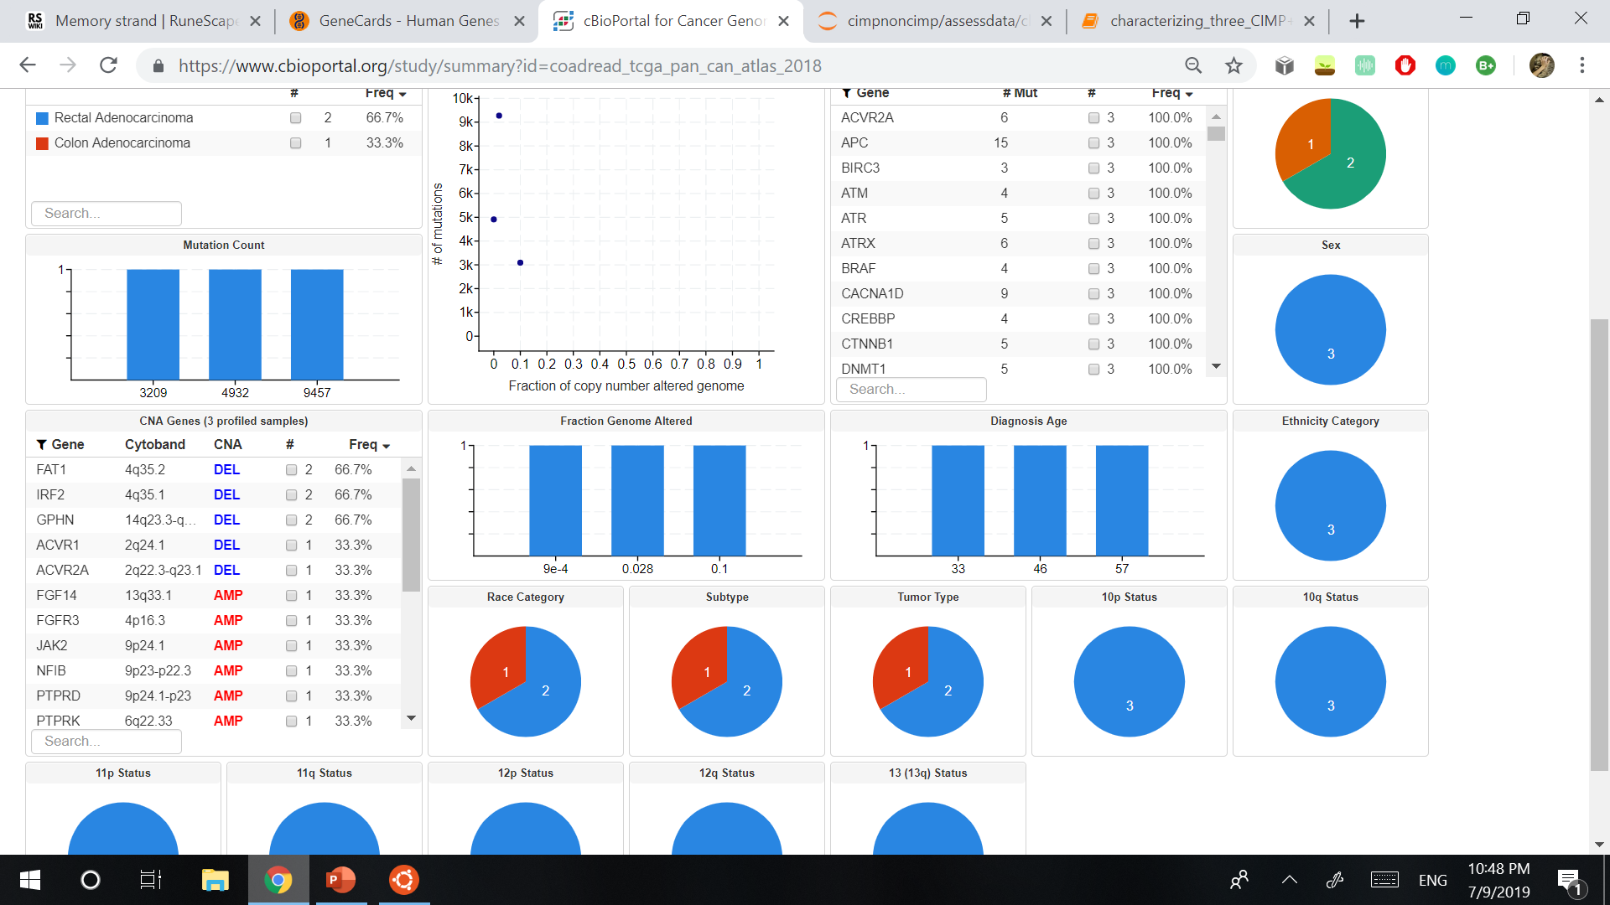
Foreground: Cluster 4
Background: All other CIMP+
CLUSTER 4 Mutations at Gene Level
Table:
Genes with >= 3 TP for Cluster 4 and FP == 0
Figure:
Genes with mutation occurrence >= 15
Gene | TP | FP | TN | FN | Fisher's Exact p-value | GeneCards info
WDR5B | 3 | 0 | 106 | 0 | 4.76E-06 | May mediate protein-protein interactions.
MLANA | 3 | 0 | 106 | 0 | 4.76E-06 | Vital role in the expression, stability, trafficking, and processing of melanocyte protein PMEL.
NFKB1 | 3 | 0 | 106 | 0 | 4.76E-06 | Transcription regulator activated by various intra- and extra-cellular stimuli and stimulates gene expression.
MCCC2 | 3 | 0 | 106 | 0 | 4.76E-06 | Catalyzes carboxylation to form 3-methylglutaconyl-CoA.
IL23R | 3 | 0 | 106 | 0 | 4.76E-06 | Associates constitutively with Janus kinase 2 (JAK2) and binds to transcription activator STAT3.
TMEM133 | 3 | 0 | 106 | 0 | 4.76E-06 | Inhibits RhoA activity to regulate vascular tone and control blood pressure.
ABHD5 | 3 | 0 | 106 | 0 | 4.76E-06 | May regulate cellular storage of triacylglycerol through activation of PNPLA2 and is involved in keratinocyte differentiation.
ERMAP | 3 | 0 | 106 | 0 | 4.76E-06 | May act as an erythroid cell receptor, possibly as a mediator of cell adhesion.
SUZ12 | 3 | 0 | 106 | 0 | 4.76E-06 | Related to sequence-specific DNA binding and chromatin binding.
PPAPDC1B | 3 | 0 | 106 | 0 | 4.76E-06 | Converts phosphatidic acid to diacylglycerol.
UTP11L | 3 | 0 | 106 | 0 | 4.76E-06 | Involved in rRNA processing and gene expression.
OR1S1 | 3 | 0 | 106 | 0 | 4.76E-06 | Encodes an olfactory receptor.
IGJ | 3 | 0 | 106 | 0 | 4.76E-06 | Related to protein homodimerization activity and antigen binding
NFKBIE | 3 | 0 | 106 | 0 | 4.76E-06 | Protein binds to NF-kappa-B, trapping complex in the cytoplasm, preventing it from activating genes.
TEX9 | 3 | 0 | 106 | 0 | 4.76E-06 | No data available.
SHOC2 | 3 | 0 | 106 | 0 | 4.76E-06 | May function as a scaffold linking RAS to downstream signal transducers in the RAS/ERK MAP kinase signaling cascade.
Associated signatures
Signature | Possible significance | Possible Drivers
Signature 10 | Altered activity of the error-prone polymerase POLE. | IDH1 (negative association)
Signature 9 | T>G transversions, found in cancers that have undergone somatic immunoglobulin gene hypermutation (IGHV-mutated) associated with AIDs. | ?
Signature 28 | Observed in a subset of stomach cancers. | ?

Slide 15
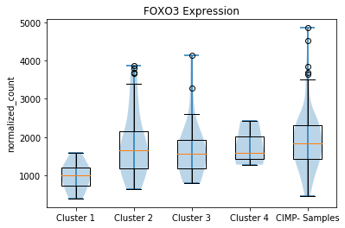
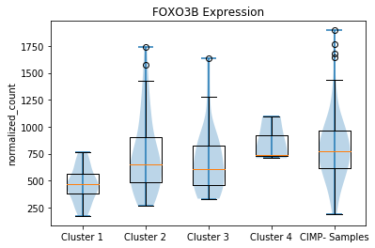
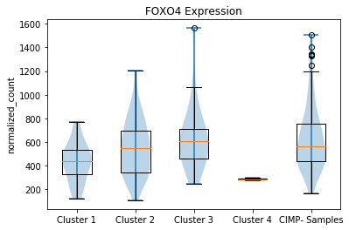
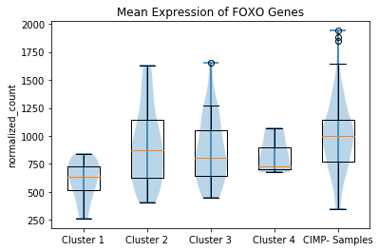
FOXO Expression in CIMP+ Clusters vs. CIMP-
P-values calculated using a two-sided t-test for the means of two independent samples of scores
Clust1 and Clust2 have p-value of 7.3185e-06
Clust1 and Clust3 have p-value of 0.0001
Clust1 and Clust4 have p-value of 0.0020
Clust1 and CIMP- have p-value of 3.5e-08
Clust1 and Clust2 have p-value of 0.0004
Clust1 and Clust3 have p-value of 0.0027
Clust1 and Clust4 have p-value of 0.0006
Clust1 and CIMP- have p-value of 4.0e-07
Clust2 and CIMP- have p-value of 0.00016
Clust3 and CIMP- have p-value of 0.00366
Clust1 and Clust2 have p-value of 0.0253
Clust1 and Clust3 have p-value of 0.0023
Clust3 and Clust4 have p-value of 0.0371
Clust1 and CIMP- have p-value of 0.0007
Clust4 and CIMP- have p-value of 0.0338
Clust1 and Clust2 have p-value of 8.88e-05
Clust1 and Clust3 have p-value of 0.0005
Clust1 and Clust4 have p-value of 0.0490
Clust1 and CIMP- have p-value of 7.00e-09
Cluster 1 has very low expression levels compared to the other groups of samples.
Cluster 3 has significantly lower FOXO1 expression compared to CIMP-

Slide 16
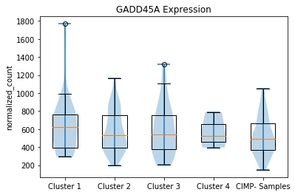
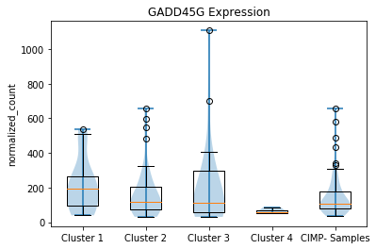
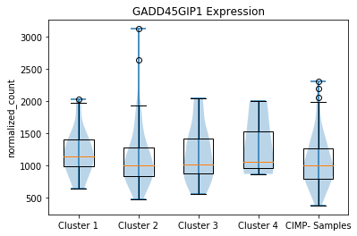
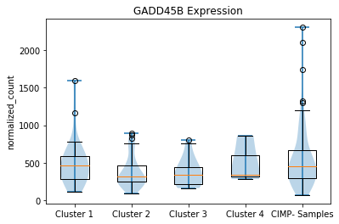
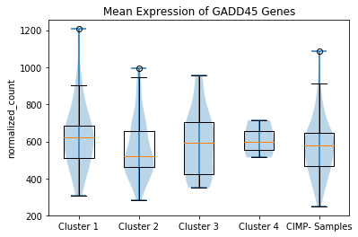
GADD45 Expression in CIMP+ Clusters vs. CIMP-
P-values calculated using a two-sided t-test for the means of two independent samples of scores
Clust1 and CIMP- have p-value of 0.0219263
Clust1 and CIMP- have p-value of 0.0059838
Clust1 and Clust2 have p-value of 0.0401310
Clust2 and CIMP- have p-value of 0.0048975
Clust3 and CIMP- have p-value of 0.0456787
Clust1 and Clust2 have p-value of 0.0401
Clust2 and CIMP- have p-value of 0.0049
Clust3 and CIMP- have p-value of 0.0457
The expression of GADD45 doesn’t appear to differ significantly between CIMP+ clusters, however there are significant comparisons against CIMP- for each of them.

